Slide 1
Nelson Mandela University Waterborne Disease Awareness
Safety, Health and Environment Department – Water Disease awareness for Staff & Students
SHE Compliance Officer

Slide 2
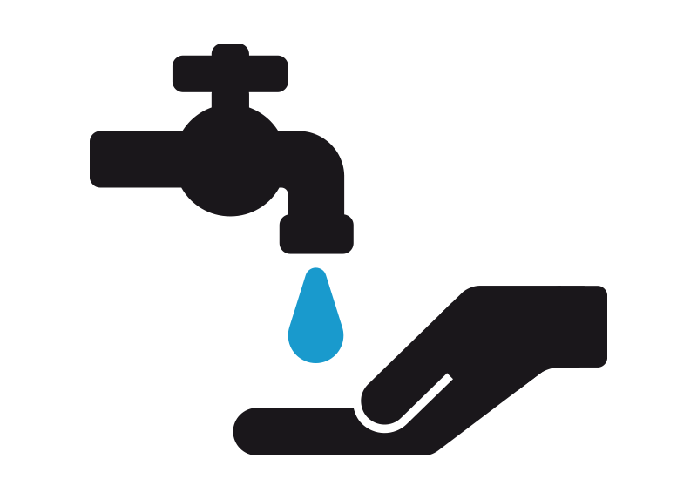
Contents
Types of Waterborne Diseases
Classifications of Waterborne Diseases.
Cholera Factsheet
Gastroenteritis Factsheet
Typhoid Fever Factsheet
Shigellosis (Shigella Dysentery) Factsheet
Bilharzia Factsheet
Water Management & Preventative Measures

Slide 3
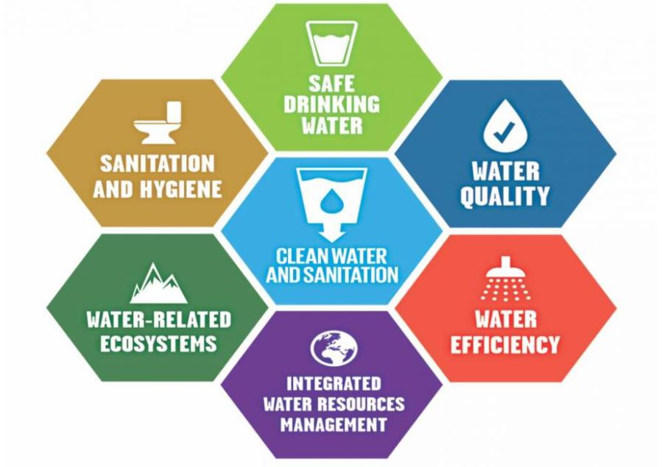
Types of Waterborne Disease
Cholera – Waterborne disease
Gastroenteritis - Water washed (Water-scarcity) and waterborne disease
Typhoid Fever - Water washed and waterborne disease
Shigellosis - Water washed and waterborne disease
Bilharzia – Waterborne and water vector disease

Slide 4
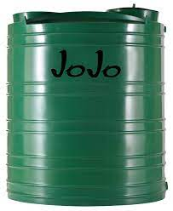
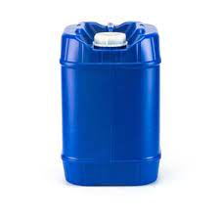
Classifications of Waterborne Diseases
Water based diseases are diseases transmitted by contact with water, e.g. Potable water.
Cholera and typhoid are transmitted through drinking water. The proper treatment of drinking water can prevent transmission.
Gastroenteritis & Shigellosis is a Water washed (water-scarcity) related disease with attention to effective sanitation for prevention. Well maintained personal hygiene with attention concerning bathroom visits and food preparations.
Bilharzia and Typhoid(Flies, passive vector) is a water vector disease that is transmitted by a vector/host (Parasite). Prevention of transmission is through a vector control.

Slide 5
Cholera
Cholera is a bacterial disease, potentially fatal
Symptoms: Loss of body fluids by diarrhoea and vomiting, leading to severe dehydration. The stool has the appearance of “rice water”.
Untreated Cholera can lead to death within 6 hours, depending on the degree of dehydration.
Transmission: Any person can contract the disease by ingesting water or food contaminated by a toxic strain of the bacterium called Vibrio Cholera.
Treatment: Urgent and immediate replacement of the water and salts is the most effective treatment for cholera. Such treatment is dramatically life- saving.

Slide 6
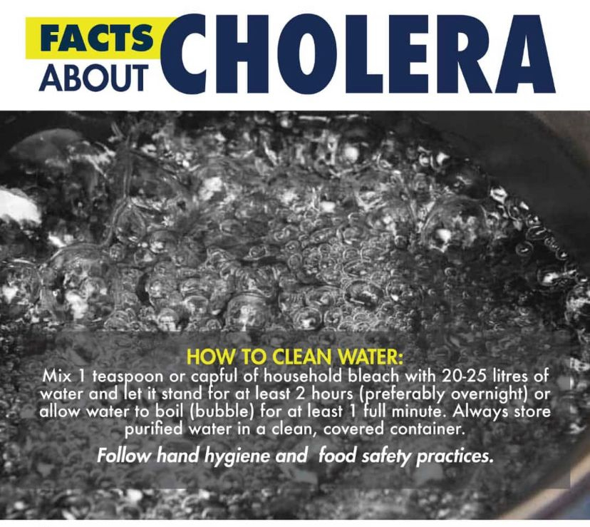
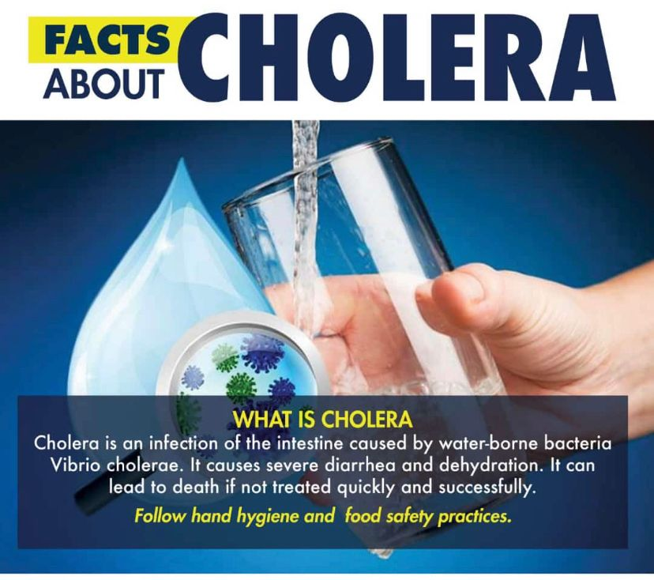
Cholera

Slide 7
Gastroenteritis
Gastroenteritis is a stomach and diarrheal flu
Symptoms: Incubation period is generally short 8 to 48 hours.
Sudden onset vomiting, watery diarrhoea often accompanied by moderate fever and stomach cramps.
Transmission: Consumption of contaminated food or drinking contaminated water.
Treatment: Urgent and immediate replacement of the water and salts that are lost, especially in infants and elderly, is of critical importance.

Slide 8
Typhoid Fever
Typhoid fever is a bacterial (Typhoid Bacilli) disease caused by Salmonella typhi.
Symptoms: Infection incubation period 1 to 3 weeks, gradual onset, starting with headaches then fever and abdominal pain.
Constipation or diarrhoea common in the early stages. Later bronchitis develops.
Transmission: Bacteria is excreted in stools of infected individuals via the faecal-oral route, or either via drinking water or food.
Flies may also play a role as a passive vector leading to food contamination.
Treatment: Antibiotics in early stage of infection is essential to prevent the appearance of life-threatening complications.

Slide 9
Shigellosis
Shigella dysentery is a bacterial infection of the genus Shigellosis.
Symptoms: Sudden onset of abdominal pain, cramps and diarrhoea. Often mucus and blood in the stools and a fever is common.
Transmission: Close person-to-person contact, contaminated food or water, via the faecal-oral route.
Hygiene/sanitation after using using bathrooms, or prior in preparation/consumption of food to prevent transmission.
Especially if a person is infected with the organism and is excreting the bacterium in the stool.
Treatment: Rehydration with fluids is necessary to prevent dehydration.
In rare cases, with kidney failure or severe rectal bleeding, hospitalisation is required.

Slide 10
Bilharzia
Bilharzia/Snail fever is a disease caused by a parasitic worm.
Symptoms: Rash, Fever, Headache, Body aches, or myalgia, Breathing difficulties, and can appear approximately 3 to 8 weeks after infection.
Transmission: Direct contact with fresh water contaminated by parasite. Affects intestinal and urinary organs. Parasite lives in the blood vessels, can harm other organs in the body.
Also, infection by consuming liquids or eating food that a person has prepared in contaminated water.
Treatment: If a person’s test result is positive, medication is usually effective as long as the individual has not experienced significant complications.

Slide 11
Water Management & Preventative Measures
Do not drink untreated water!
Clean drinking water before use or consumption, effective sanitation and hygiene is important.
Water can be disinfected!
By adding one teaspoon(5ml) of domestic bleach to 20 litres of water and leaving it for one hour before drinking. If no bleach is available, the water can be boiled vigorously for at least five minutes and kept simmering for at least another 15 minutes (take care to avoid burns). If the water is cloudy, add 2 to 3 extra teaspoon of bleach
Proper personal hygiene and sanitation!
Wash and peel fruit and vegetables before eating, all food preparation surfaces and areas should be hygienic and clean. Wash your hands after going to the toilet and before preparing food.
Clean drinking water containers. Recontamination of stored clean water should be avoided by not inserting the hands or dirty equipment when removing water from the container.

Slide 12
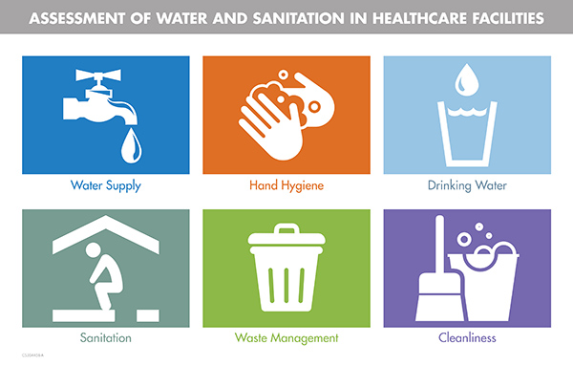
Contact Concerns
If any persons are experiencing any symptoms mentioned above:
Staff, please Contact/Visit Occupational health.
Waterborne illnesses: occupationalhealth@mandela.ac.za
Students, please Contact/Visit Campus Health Services Centers
Waterborne illnesses: studenthealthservices@mandela.ac.za
If you have any other concerns relating to water:
Water quality: SHE@mandela.ac.za
Water leaks or vandalism: water@mandela.ac.za

